Slide 1
Enterprise Systems Development – Sprint 2
Group Members:
Austin Harper, Conran Pearce, Harrison Bennion, Morgan Welch and Sam Kirk
https://github.com/m3-welch/ESD-Group-3-CW1

Slide 2
Progress Summary
Initial task planning and documentation between group members, after reviewing feedback for sprint 1.
Implementation of a backend architecture which included system functionalities through servlets and basic front-end user interface.
The database tables were extended to allow functionality, such as bookings and prescriptions to be made.
New Java classes have been created to allow changes to the database tables, such as a Bookings.java file being created which can interact with the bookings table.
Extended front-end with basic functionality of back-end.

Slide 3
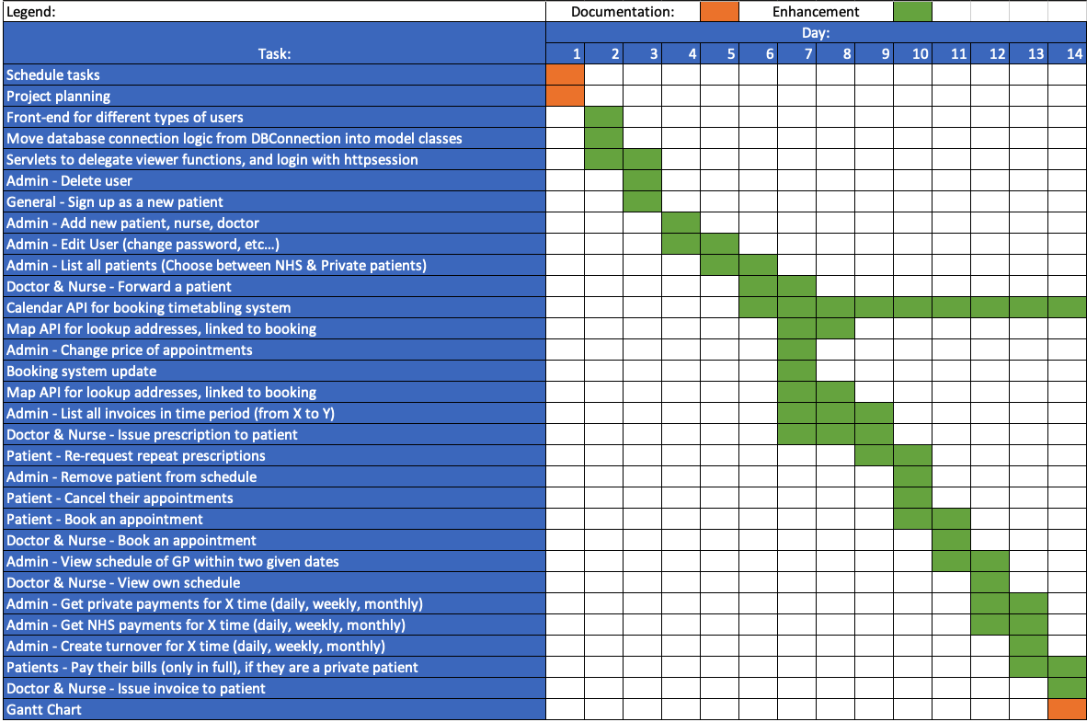
Sprint 2 Project Plan (Gantt Chart)

Slide 4
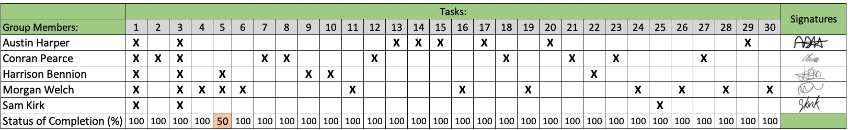
Task Delivery Form

Slide 5
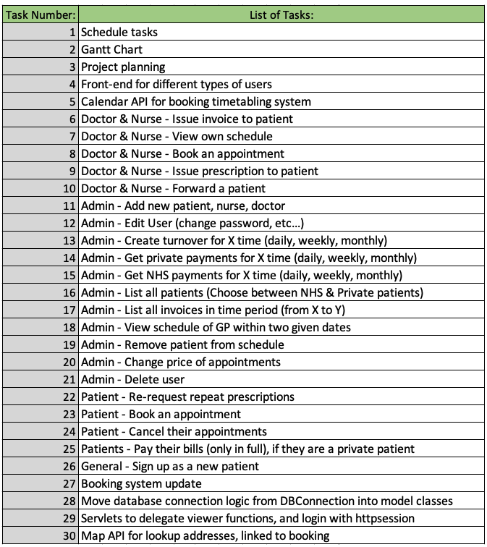
Task Delivery Form - Tasks

Slide 6
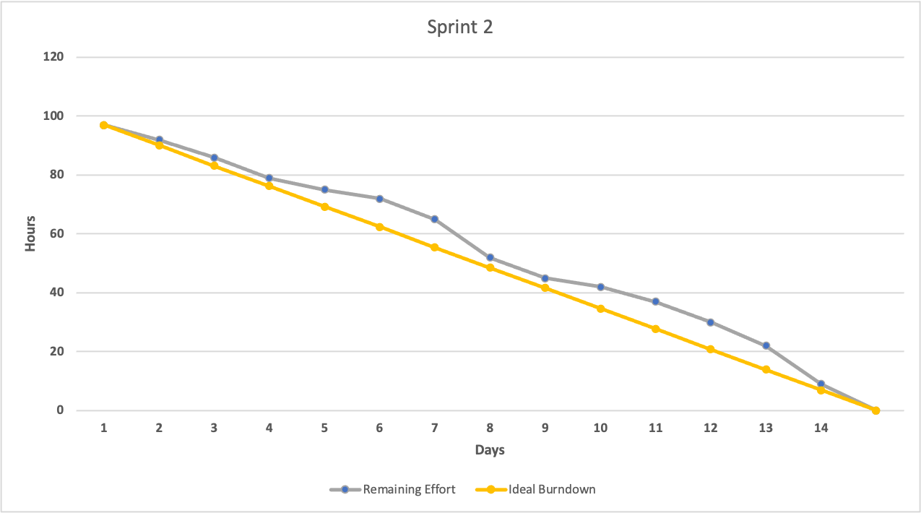
Burn Down Chart

Slide 7
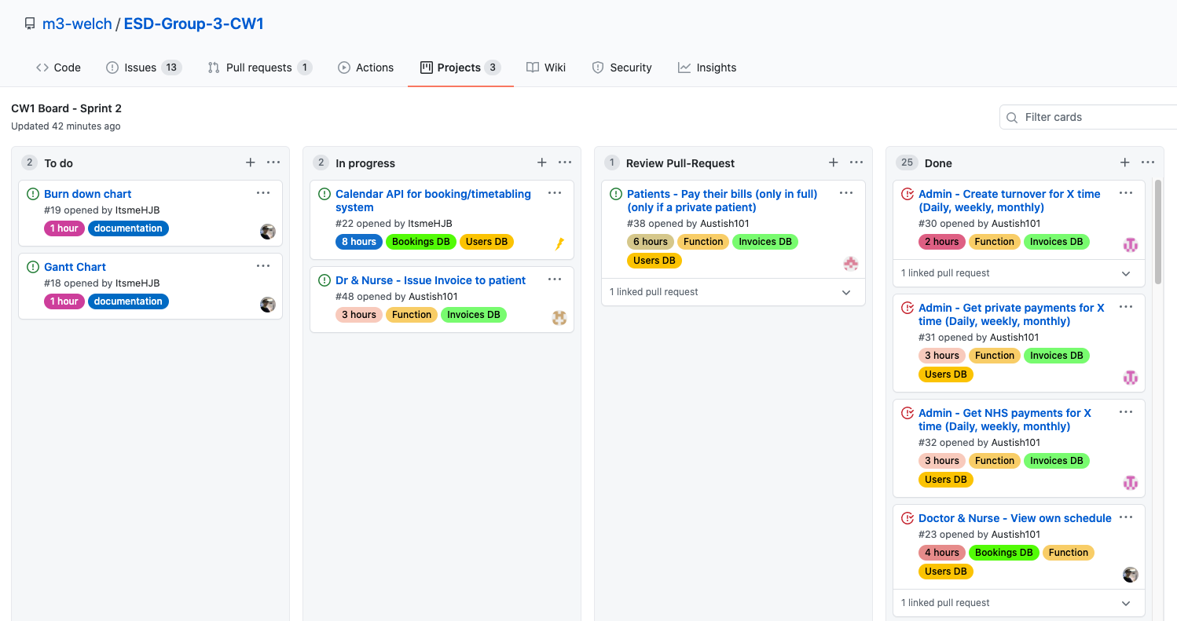
GitHub – Kanban Project

Slide 8
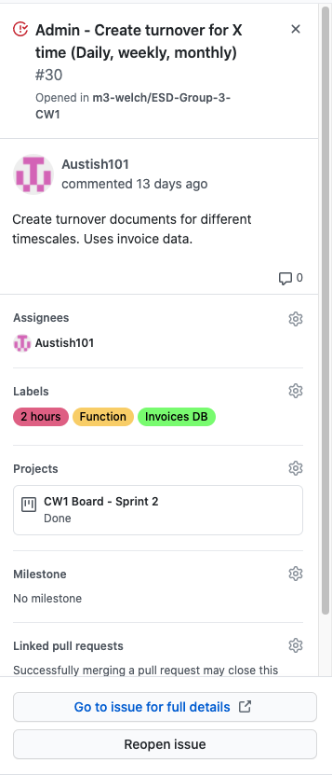
GitHub – Issues

Slide 9
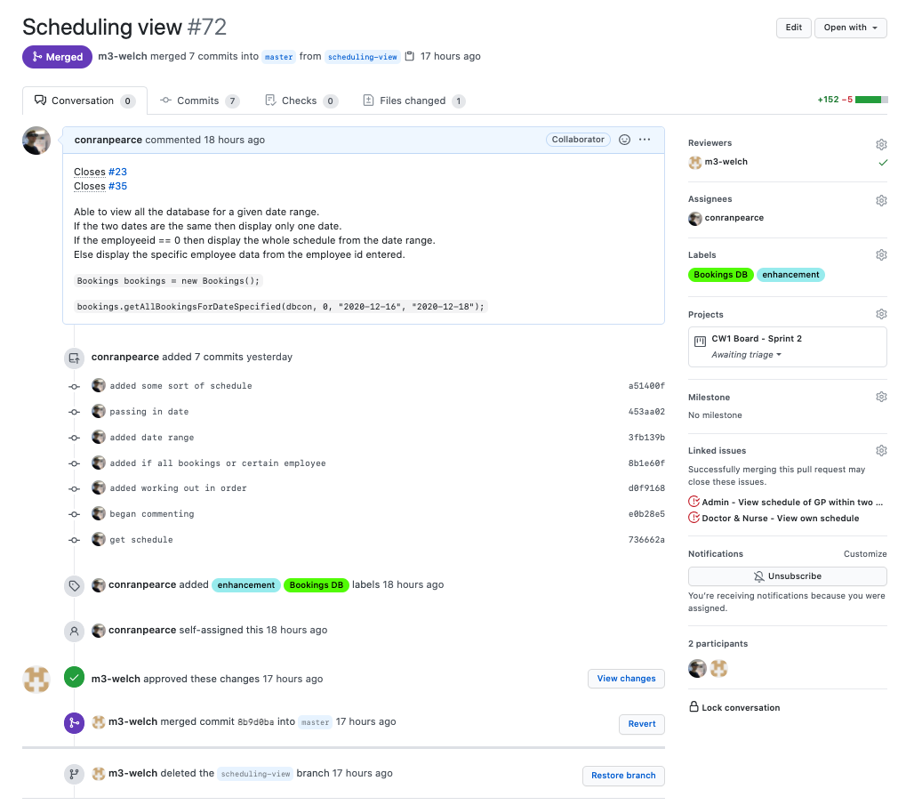
GitHub – Pull requests

Slide 10

Team Meetings and Communication

Slide 11
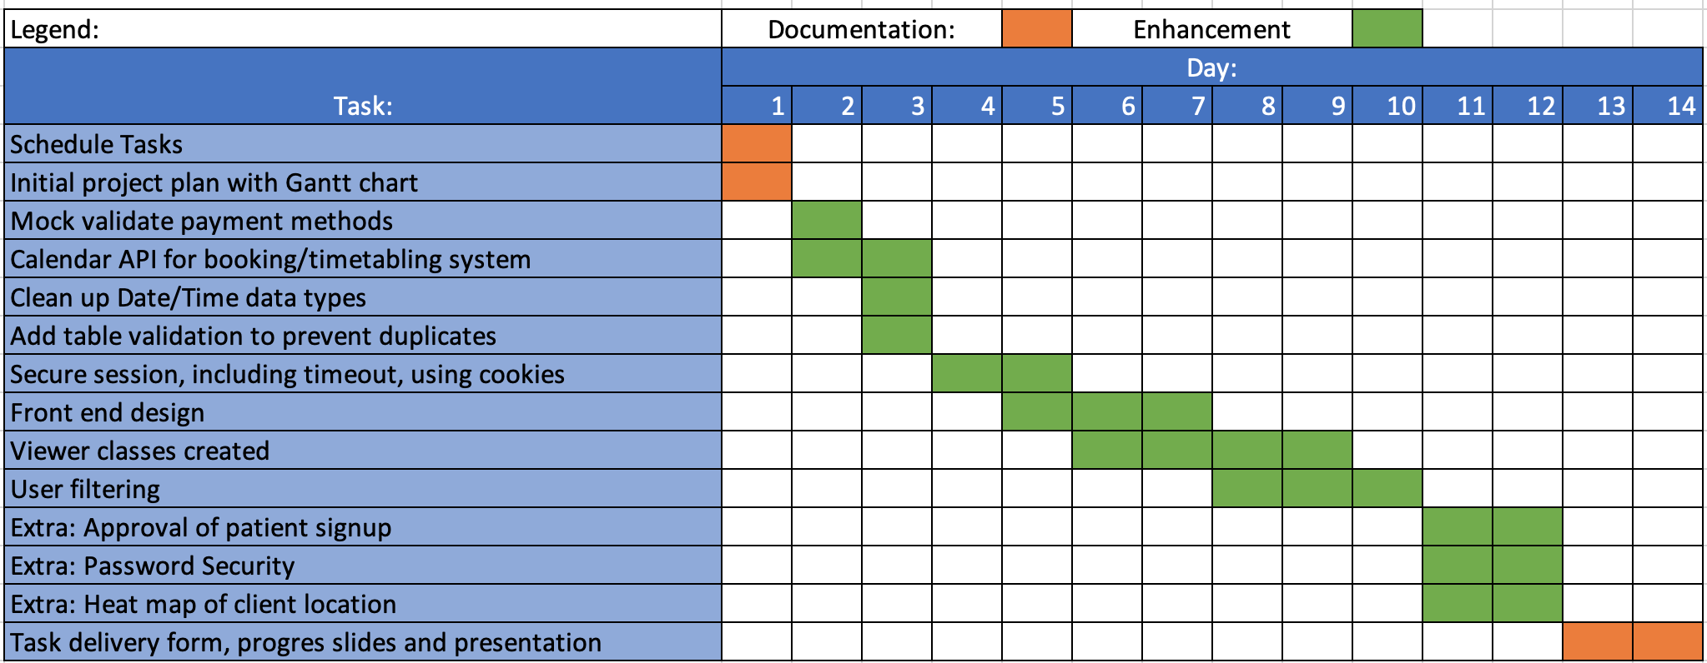
Sprint Review – Sprint 3 Gantt Chart

